Slide 1
Memento and Strategy pattern
Memento pattern
Strategy pattern
Quiz
2018.11.14

Slide 2
1. Memento pattern – Problem Description
The internal state of an object should be saved externally so that the object can be restored to this state later.
The object's encapsulation must not be violated.

Slide 3
1. Memento pattern – Definition
The memento pattern is a software design pattern that provides the ability to restore an object to its previous state (undo via rollback).
The Memento Design Pattern is used to store the internal state of an object so that it can be used later to restore the object back to historical state when needed..
Memento pattern falls under behavioral pattern category.

Slide 4
1. Memento pattern – Definition
The Memento design pattern evolves three actors
Originator
CareTaker
Memento

Slide 5
1. Memento pattern – Definition
Originator
The object whose state we want to save for future use. It creates memento object capturing its internal state. It also uses previously saved memento to restore to its previous state.

Slide 6
1. Memento pattern – Definition
CareTaker
The object which maintains the history of the states of Originator. It provides the data store for saving and restoring internal states. It cannot read or change the data of a memento object.

Slide 7
1. Memento pattern – Definition
Memento
It is used to store the internal states of Originator at any moment of time. It is created and retrieved by the Originator and stored and maintained by Caretaker.
The Originator will store the state information in the Memento object and pass it to a CareTaker for storing it and retrieve old state information when it needs to rollback.

Slide 8
1. Memento pattern – Definition
The Memento design pattern evolves three actors
Originator : The object whose state we want to save for future use. It creates memento object capturing its internal state. It also uses previously saved memento to restore to its previous state.
CareTaker : The object which maintains the history of the states of Originator. It provides the data store for saving and restoring internal states. It cannot read or change the data of a memento object.
Memento : It is used to store the internal states of Originator at any moment of time. It is created and retrieved by the Originator and stored and maintained by Caretaker.
The Originator will store the state information in the Memento object and pass it to a CareTaker for storing it and retrieve old state information when it needs to rollback.

Slide 9
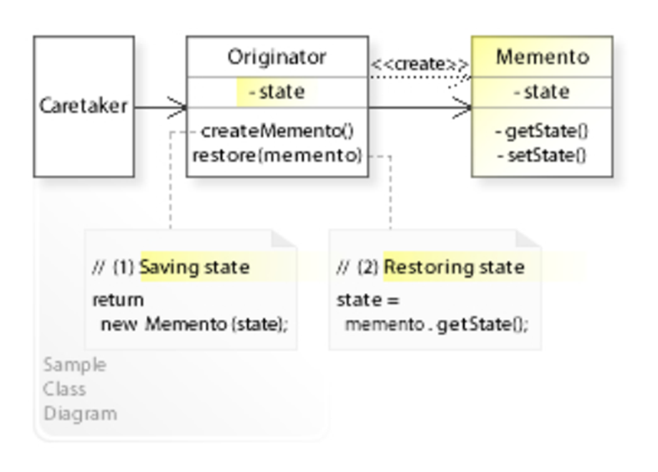
1. Memento pattern – Class diagram

Slide 10
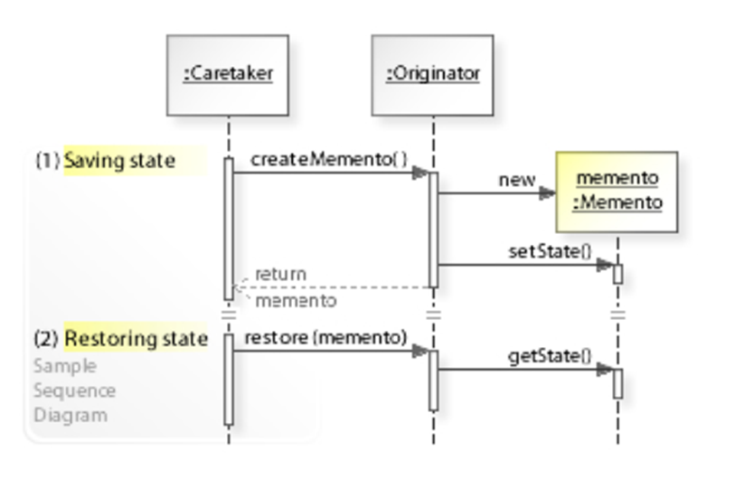
1. Memento pattern – Sequence diagram

Slide 11
1. Memento pattern – Advantages
It stores the objects state without compromising encapsulation.
Provides a recovery mechanism in case of failures.
It provides a way to maintain history of an object's life cycle.

Slide 12
1. Memento pattern – Disadvantages
Using mementos might be expensive.
Mementos might incur considerable overhead if Originator must copy large amounts of information to store in the memento or if clients create and return mementos to the originator often enough. Unless encapsulating and restoring Originator state is cheap, the pattern might not be appropriate.

Slide 13
1. Memento pattern – Disadvantages
Defining narrow and wide interfaces. It may be difficult in some languages to ensure that only the originator can access the memento's state.
Memento object must provide two types of interfaces: narrow interface for Caretaker and a wide interface for the Originator.
Enables the other object to arbitrarily change the state of object.

Slide 14
1. Memento pattern – Source code demo

Slide 15
2. Strategy pattern – Definition
Strategy pattern is one of the behavioral design pattern.
In computer programming, the strategy pattern (also known as the policy pattern) is a behavioral software design pattern that enables selecting an algorithm at runtime. Instead of implementing a single algorithm directly, code receives run-time instructions as to which in a family of algorithms to use

Slide 16
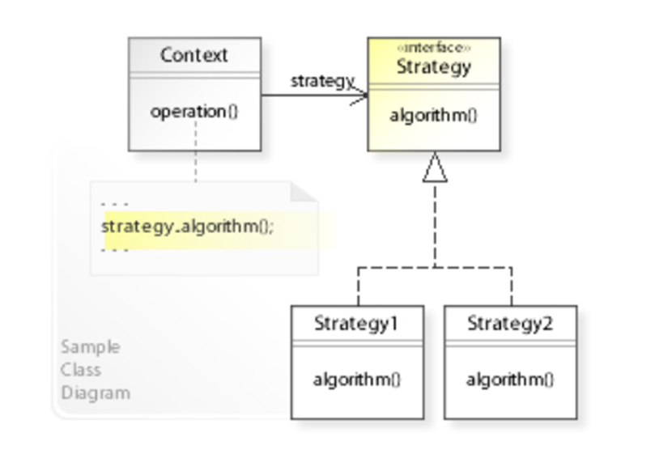
2. Strategy pattern – Class diagram

Slide 17
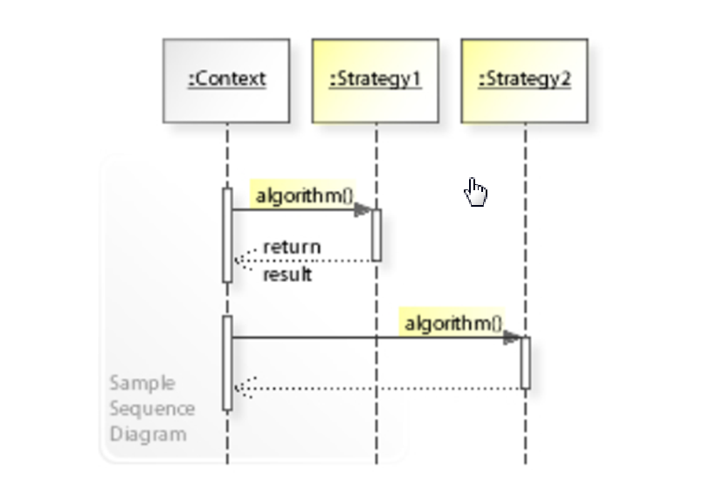
2. Strategy pattern – Sequence diagram

Slide 18
2. Strategy pattern – Advantages
A family of algorithms can be defined as a class hierarchy and can be used interchangeably to alter application behavior without changing its architecture.
By encapsulating the algorithm separately, new algorithms complying with the same interface can be easily introduced.
The application can switch strategies at run-time.

Slide 19
2. Strategy pattern – Advantages
Strategy enables the clients to choose the required algorithm, without using a “switch” statement or a series of “if-else” statements.
Data structures used for implementing the algorithm are completely encapsulated in Strategy classes. Therefore, the implementation of an algorithm can be changed without affecting the Context class.

Slide 20
2. Strategy pattern – Disadvantages
The application must be aware of all the strategies to select the right one for the right situation.
Context and the Strategy classes normally communicate through the interface specified by the abstract Strategy base class. Strategy base class must expose interface for all the required behaviours, which some concrete Strategy classes might not implement.

Slide 21
2. Strategy pattern – Disadvantages
In most cases, the application configures the Context with the required Strategy object. Therefore, the application needs to create and maintain two objects in place of one.

Slide 22
2. Strategy pattern – Source code demo

Slide 23
4. Quiz
What kind of Memento pattern? a. Creational b. Structural c. Behavioral d. Concurrency
What kind of Strategy pattern? a. Creational b. Behavioral c. Structural d. Concurrency
What are the Disadvantages of Memento pattern?
a. The number of classes grows up
b. Nothing
c. Memory leaks caused by Lapsed listener problem
d. This pattern avoids duplication of objects which might be huge size and memory intensive.
What is the benefit of Strategy pattern pattern?
a. A class can change its behavior at run-time by changing its current state object.
b. New states can be added by defining new state classes.
c. One of the advantages of this pattern is security.
d. a class independent of how state-specific behavior is implemented.
How many class types need to implement in Memento pattern?
a. 4 b. many c. 2 d. 8

Slide 24
End…
Thank you!

